Slide 1
Introduction to Python
Workshop 0

Slide 2
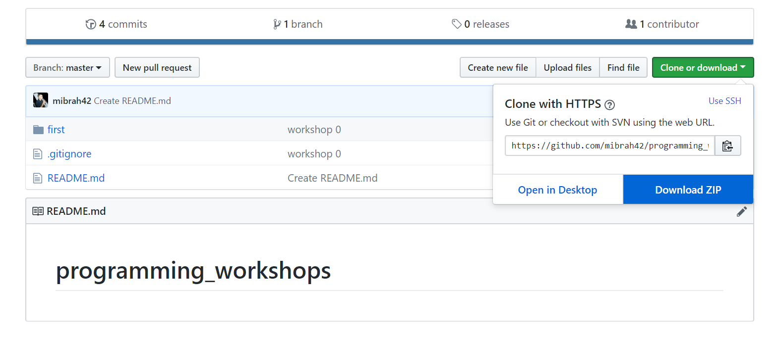
Download workshop folder
https://github.com/mibrah42/programming_workshops

Slide 3
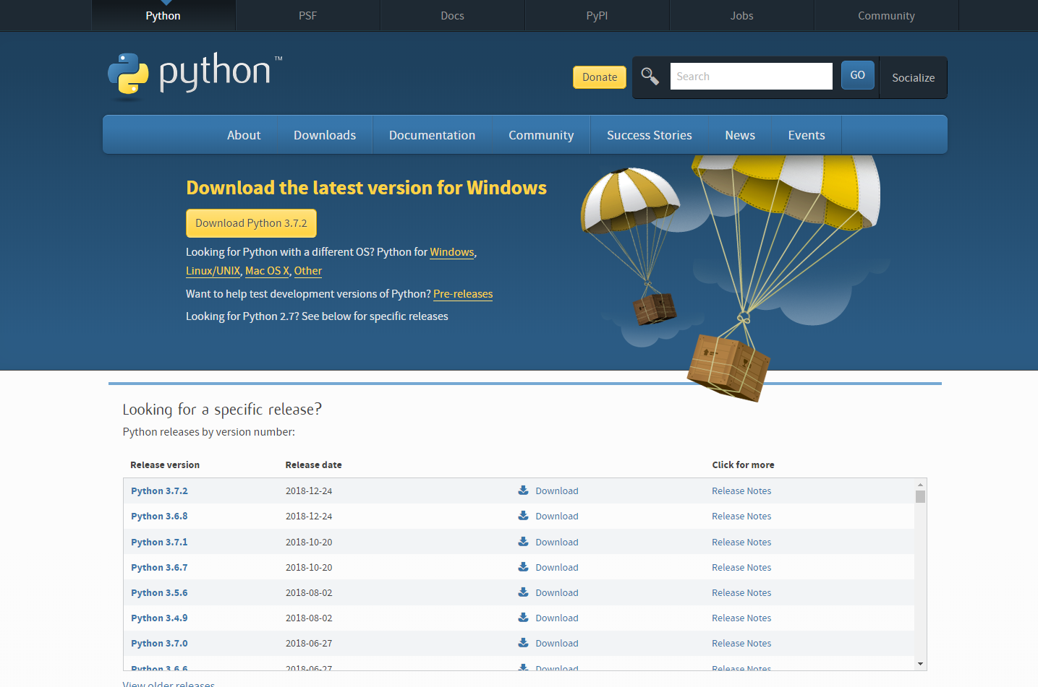
Install python
https://www.python.org/downloads/

Slide 4
Install pip and pytest
Click on the get-pip.py file from the downloaded repository
Check if it has installed by typing pip in the command prompt.
# type pip in the command prompt pip # if it is not recognized type py -m pip # for pytest, type py –m pip install pytest

Slide 5
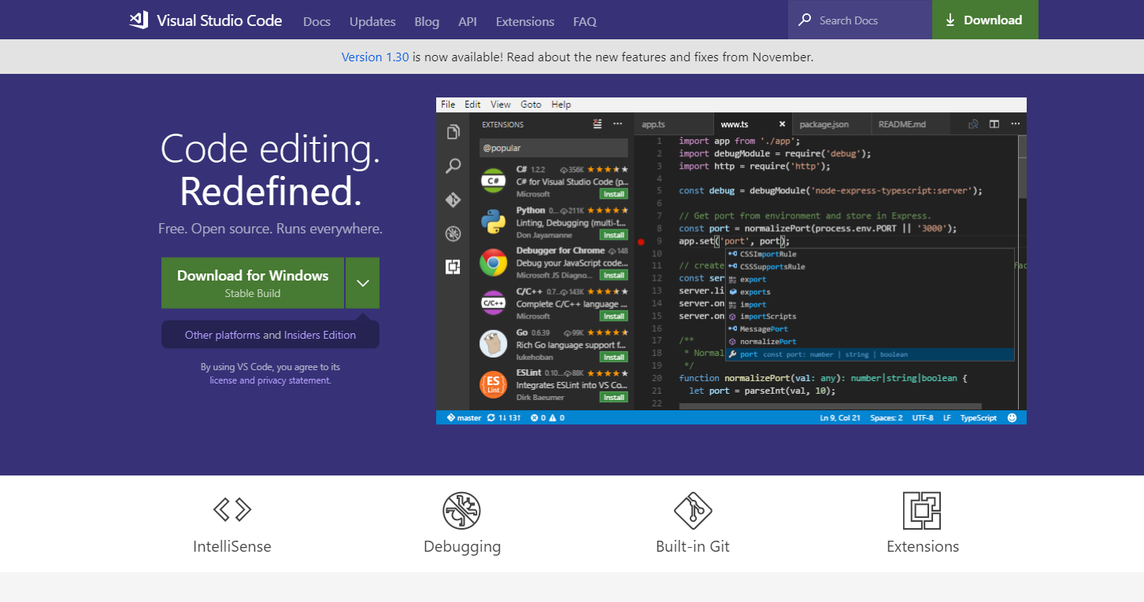
Install vscode
https://code.visualstudio.com/

Slide 6
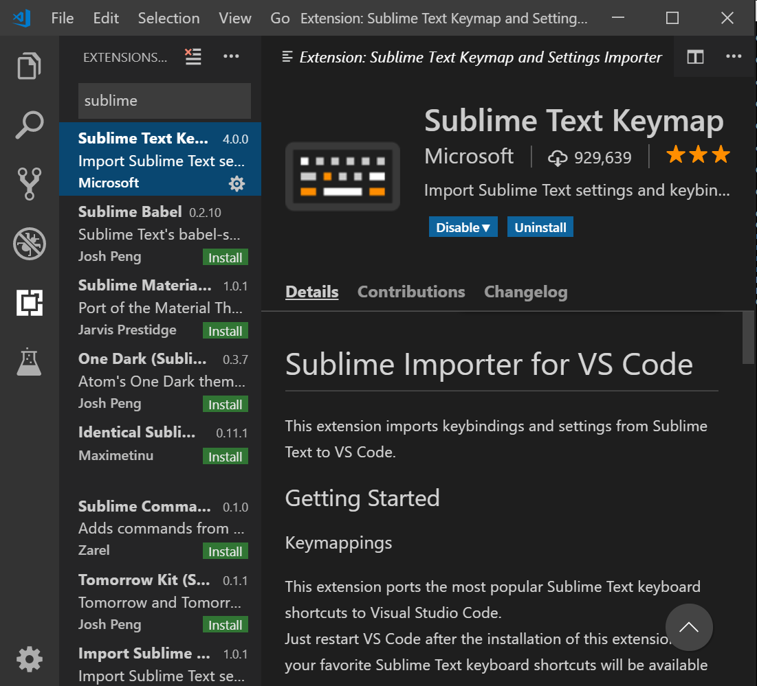
Add sublime text keymap plugin (optional)

Slide 7
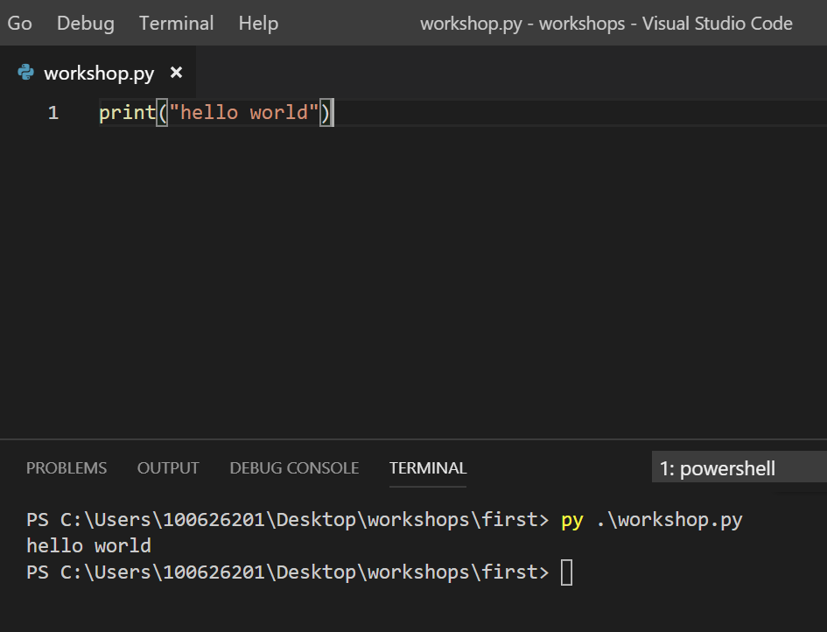
How to run your code
Create new file ending in .py
Write your script
Run it from the terminal using the command: py filename.py

Slide 8
Variables
Variables store data
Python gives us a few data types to work with:
Use type(item) to get the type of a variable
i = 23 # int f = 3.5 # float s = “hello world” # str b = True # bool n = None # NoneType

Slide 9
Working with numbers
Mathematical Operators
+ , - , * , / , // (floor division), % (remainder) ,** (exponentiation)
print(3 + 3) # 6 print(5 + (6 * 4)) # 29 print(2**2) # 4
Converting int -> floats
float(23) # 23.0 int(14.3) # 14 int(14.99) # 14 truncates decimal, doesn’t round round(14.99) # 15 use this instead

Slide 10
Functions
Functions group related pieces of code together making your program easier to understand and maintain.
def add(x,y): return x + y print(add(2,3)) # 5

Slide 11
Importing
from filename import functionName # example from math import pi from myLibrary import add

Slide 12
Exercise 1

Slide 13
Working with strings
firstName = "bob" lastName = "marley" fullName = firstName + " " + lastName # another way: fullName = f"{firstName} {lastName}" print(fullName) # bob marley print(name.upper()) # BOB print(len(fullName)) # 10

Slide 14
Taking input from the user
# with user input name = input("enter your name: ") print("my name is " + name)

Slide 15
Conditional statements
Comparison operators: ==, !=, >, <, >=, <=
Logical operators: and, or, not
age = 17 if age > 16: print("you can drive") else: print("you can't drive") # output: you can drive

Slide 16
Collection types
Data types that hold more than one value
Used for storing a collection of related items
l = [1,2,3,4] # list mySet = set([3,4,6]) # set: similar to list but has unique values myDictionary = {"key": "value"} # dict myTuple = (3.2,5.6) # tuple

Slide 17
Accessing and manipulating collections
Arrays
numbers = [34,7,4,24,5] print(numbers[0]) # 34 numbers[0] = 16 print(numbers[0]) # 16 numbers.append(5) # add 5 to numbers numbers.pop() # removes last element and returns it numbers.pop(0) # removes first element and returns it

Slide 18
Exercise 2

Slide 19
Accessing and manipulating collections
Dictionaries
inventory = { "iphone X": 16, "apple airpods": 0, "ipad pro": 7 } print(inventory["ipad pro"]) # 7 inventory["ipad pro"] = 6 print(inventory["ipad pro"]) # 6 del inventory["iphone X"] print(inventory) # {'apple airpods': 0, 'ipad pro': 6}

Slide 20
Accessing and manipulating collections
Sets
mySet = set([34,3,6]) print(mySet) # {34, 3, 6} mySet.remove(34) print(mySet) # {3, 6} mySet.add(1) print(mySet) # {1, 3, 6}

Slide 21
Loops
For loops
for i in range(5): print(i)
numbers = [1,3,4,5] for number in numbers: print(number)

Slide 22
Loops
While loop
i = 5 while i > 0: print(i) i -= 1

Slide 23
Exercise 3

Slide 24
Have a great weekend !

